Slide 1


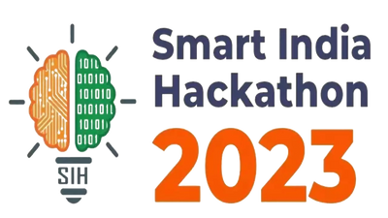


Basic Details of the Team & Problem Statement
Ministry/Organization Name/Student Innovation:
Problem Type:
Problem Statement Code:
Problem Statement Title:
Team Name:
Team Leader Name:
Institute Code (AISHE):
Institute Name:
Theme Name:
Ministry of AYUSH
Software
SIH1347
A software that suggests drugs and formulations for a disease / pharmacological property based on the Ayurvedic classical books / repositories.
Therap-you-tics
Aayushi Gupta
U-0923
VIT Bhopal University
MedTech / BioTech / HealthTech

Slide 2

Idea / Approach Details
Health Harmony - Revolutionizing Health Management
Team Therap-you-tics brings to you easy, ayurvedic diagnosis at your fingertips - Health Harmony.
We aim to develop an interactive website that helps in the accurate diagnosis and subsequent treatment of various ailments through Ayurvedic principles.
This website will utilize Ayurvedic parameters along with immediate symptoms that the client enters to diagnose. It will subsequently prescribe lifestyle changes such as the incorporation of yoga into one’s schedule, and certain Ayurvedic medicines.
It may also recommend getting in touch with a physician based on its assessment of severity of illness (The SOS feature).
We will also introduce a mobile app that will additionally track the vitals of the user and utilize this data for diagnosis along with the aforementioned features. In the future, we may also incorporate the Google Maps feature into the website and app in order to make the recommended medicines and physicians easily accessible.
‹#›

Slide 3
Idea / Approach Details
Technology Stack
We will build a cross-platform app for the users with our knowledge of three different languages (C, JAVA and Python).
The mobile app will be programmed using C# or JavaScript.
The frameworks used for our app development will either be Flutter, Xamarin or React Native.
Users can access our app with any device that they want.
We are also going to make a connected website which will help monitor everything, even with the big devices.

Slide 4

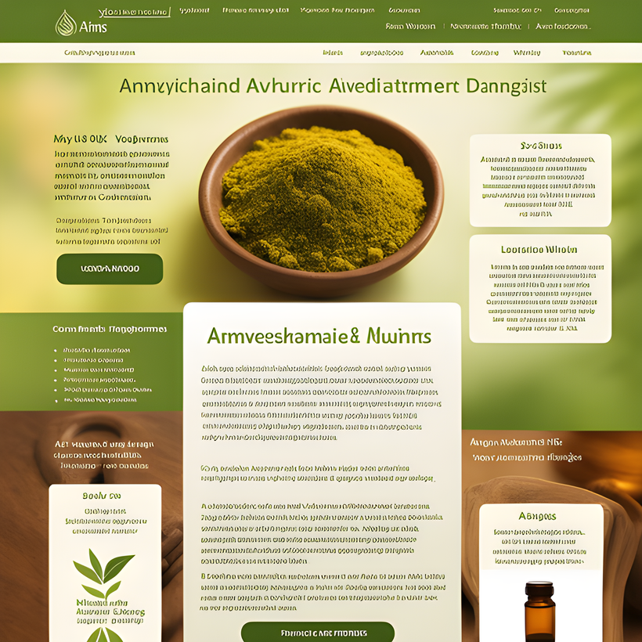

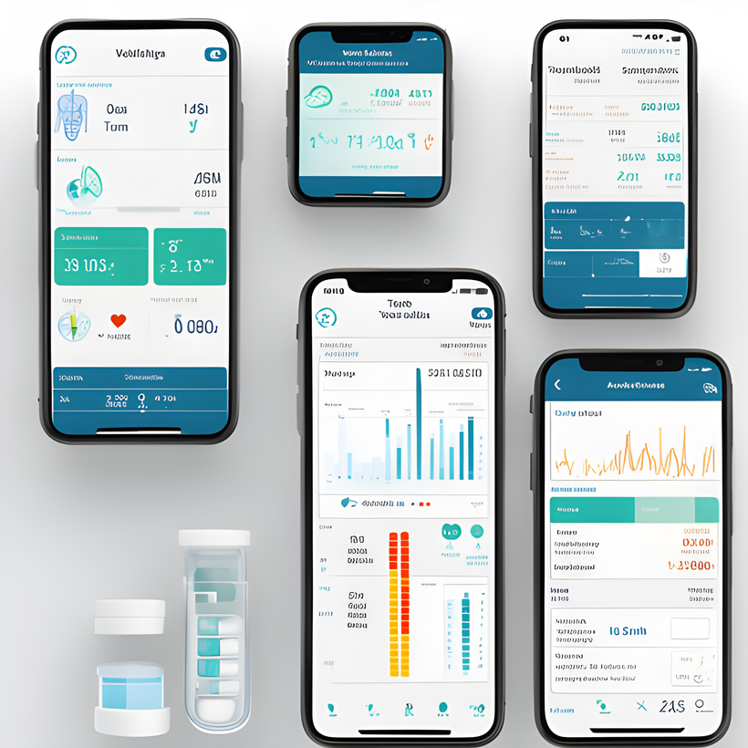
Idea / Approach Details
Stages of release
We Plan to unfold the project in two stages, starting with a Website and followed by a Mobile Application.
Representative images
Website:
Aims for accurate diagnosis and treatment.
Utilizes Ayurvedic principles.
Prescribes lifestyle changes like yoga.
Considers immediate symptoms.
Recommends Ayurvedic medicines.
May suggest contacting a physician.
Mobile Application:
Tracks user's vitals.
Uses vital data for diagnosis.
Considers immediate symptoms.
Offers the same features as the website.
Enhances accessibility to physicians.
Features an SOS function for severe illnesses.

Slide 5
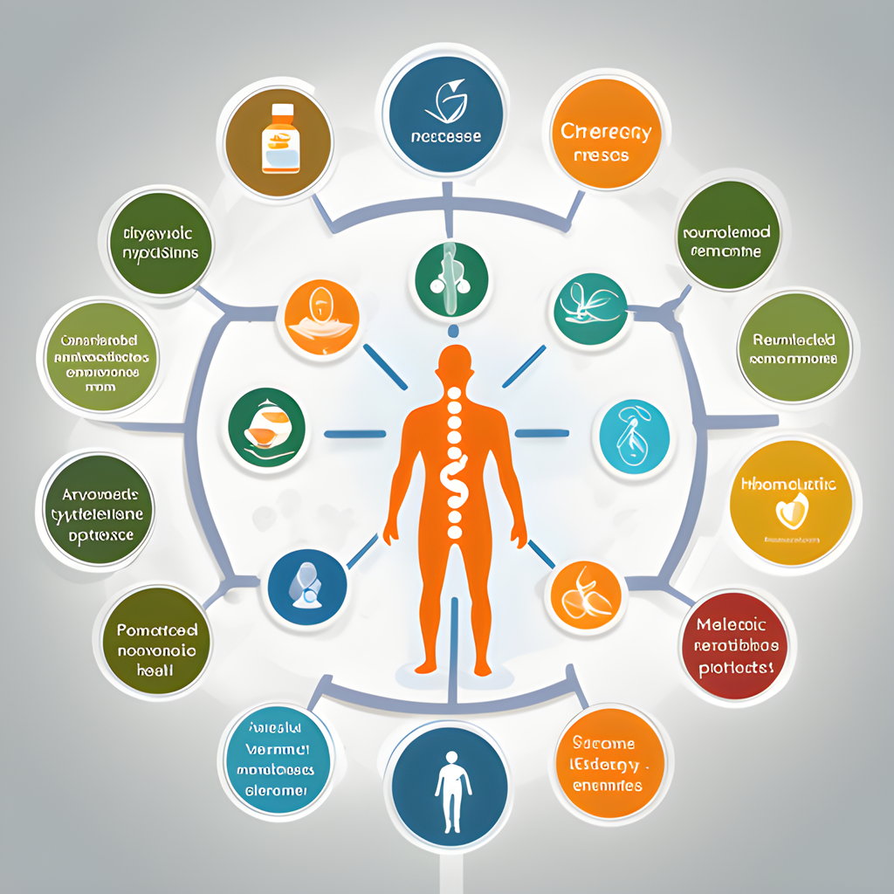

Idea / Approach Details
Representative Image
Real-World Applications of Health Harmony
Health Harmony can be used in various real-world scenarios:
Daily health monitoring
Managing lifestyle diseases
Emergency health response
Easy access to prescribed medicines and recommended physicians.
Dependencies: Access to a database of Ayurvedic remedies and emergency contact information.

Slide 6

Software / Hardware Specifications
The Technology Behind Health Harmony
Our app operates on both web and mobile platforms.
Backend: Wix website builder, Python, and C libraries.
Frontend: User-friendly and intuitive interface.
Hardware: Compatible with most smartphones.
Representative Image
Notes:
‹#›

Slide 7
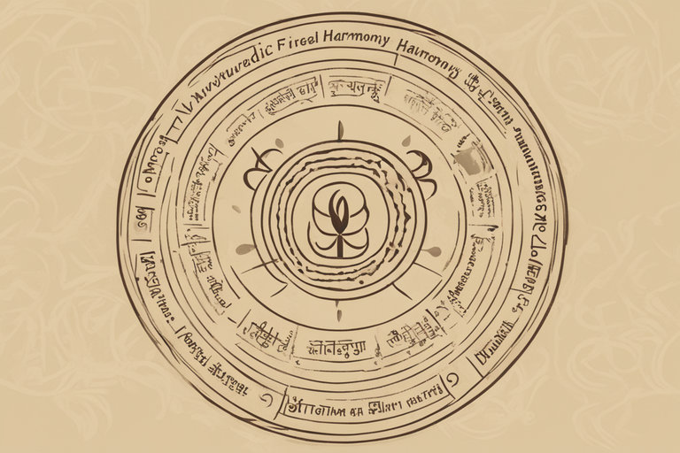
Methodology & Working Principle
The Science Behind Health Harmony
Ayurvedic Foundation:
Health Harmony is built upon Ayurvedic principles, focusing on the 'Mool Siddhant' (fundamentals) of Ayurveda. It aims to diagnose diseases by addressing the root causes that disrupt the body's balance, utilizing Panchakarma procedures and medicine.
Continuous Health Monitoring:
The platform continuously monitors the user's health, including vital signs like pulse rate and blood pressure.
Representative Image
Notes:
‹#›

Slide 8
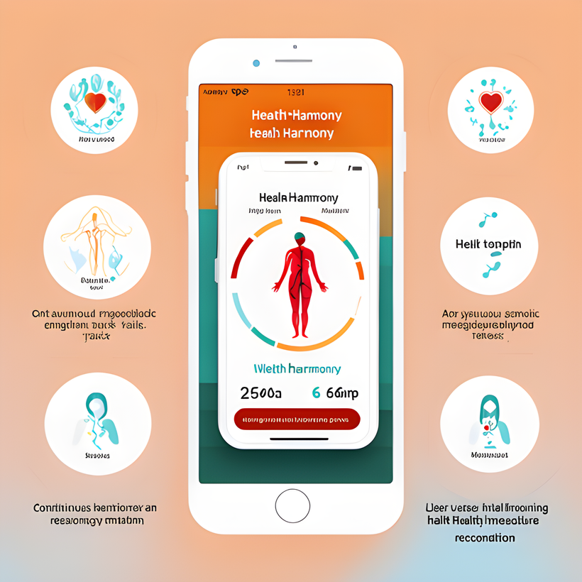
Methodology & Working Principle
The Science Behind Health Harmony
User-Friendly Interface:
To ensure ease of use, we are developing an interactive and user-friendly user interface (UI). Users can easily engage with the app and access their medical vitals, presented in visual formats like charts and graphs.
Immediate Response:
In cases where significant irregularities in vital signs are detected, the app prompts the user to provide additional symptoms. This information is used to recommend personalized emergency measures promptly.
Representative Image
Notes:
‹#›

Slide 9
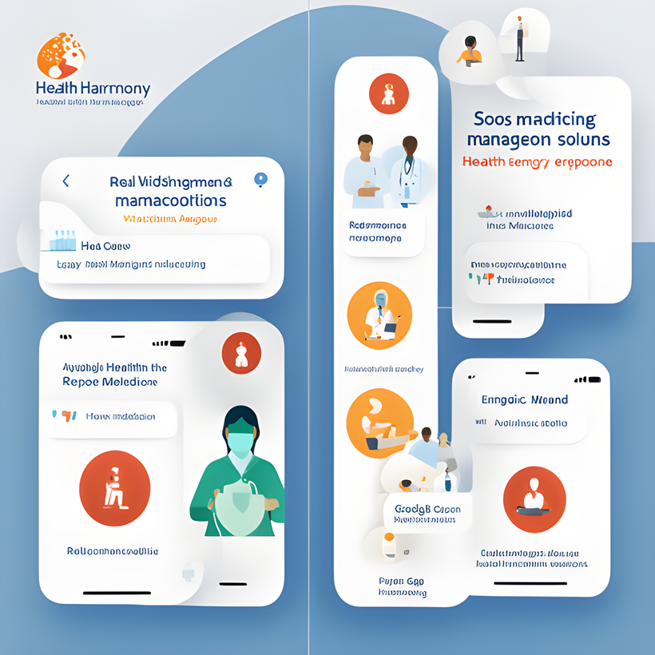
Novelty
Uniqueness and Innovation in Health Harmony
What sets Health Harmony apart:
Real-time health monitoring and emergency response with the SOS feature.
Personalized health recommendations.
Easy access to recommended medicines and physicians with the incorporation of the Google Maps feature.
Integration of Ayurvedic wisdom into modern health management.
Bridging the gap in existing healthcare solutions.
Representative Image
Notes:
‹#›

Slide 10
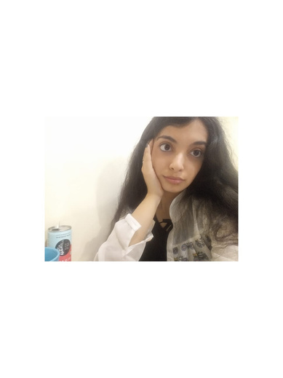

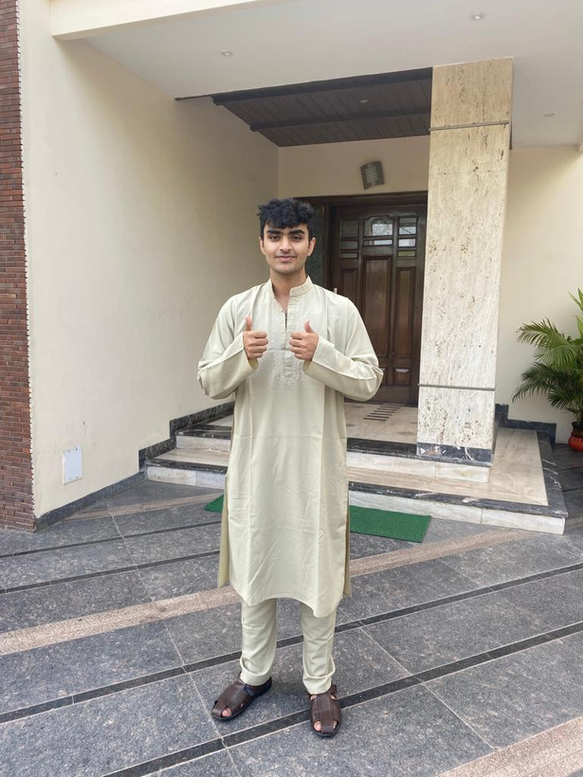
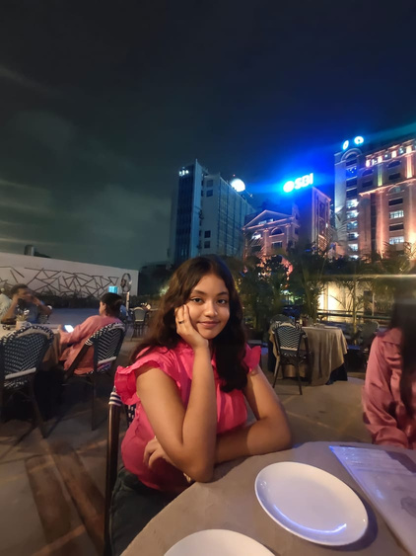
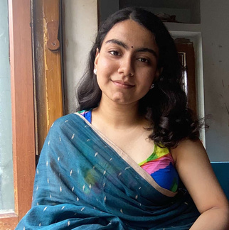
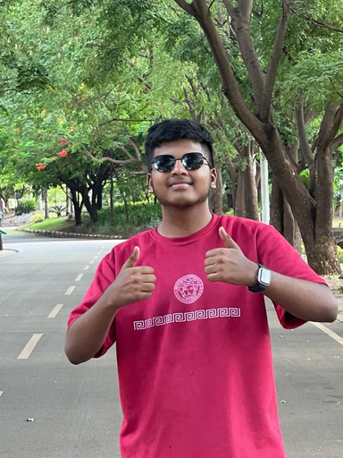
Pic L | Aayushi Gupta | Aayushi Gupta | Aayushi Gupta | Aayushi Gupta
Pic L | B. Tech | Bioengineering | Year I | Concept Builder Collaborator
Pic 1 | Ramanuj Bhattacharyya | Ramanuj Bhattacharyya | Ramanuj Bhattacharyya | Ramanuj Bhattacharyya
Pic 1 | B.Tech | Bioengineering | Year I | Graphics Designer Web Devoloper
Pic 2 | Vivaswan Nanda | Vivaswan Nanda | Vivaswan Nanda | Vivaswan Nanda
Pic 2 | B.Tech | CSE Core | Year I | Lead Programmer (C)
Pic 3 | Ahana Sengupta | Ahana Sengupta | Ahana Sengupta | Ahana Sengupta
Pic 3 | B.Tech | Bioengineering | Year I | Researcher
Pic 4 | Roopkatha Chandra | Roopkatha Chandra | Roopkatha Chandra | Roopkatha Chandra
Pic 4 | B.Tech | Bioengineering | Year I | Researcher
Pic 5 | Taufiq Ahamed | Taufiq Ahamed | Taufiq Ahamed | Taufiq Ahamed
Pic 5 | B.Tech | CSE Core | Year I | Lead Programmer (Python)
Team Member Details

